Slide 1
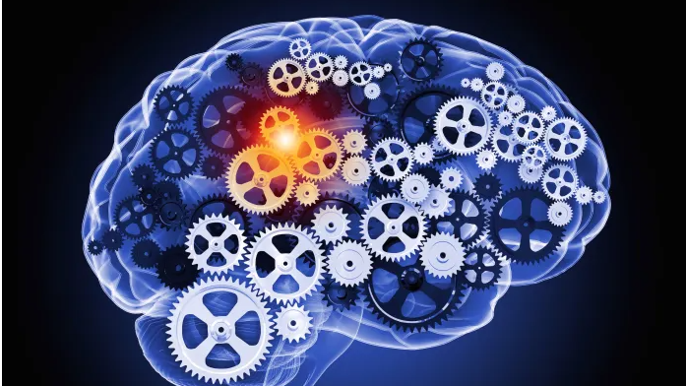
Hybrid Learning
Mohsen Pourvali
NLP&CA
AI Lab

Slide 2
Outline
Natural Language Processing (NLP)
Motivation
A taxonomy
A few case studies
Our experiments
Challenges and discussion

Slide 3
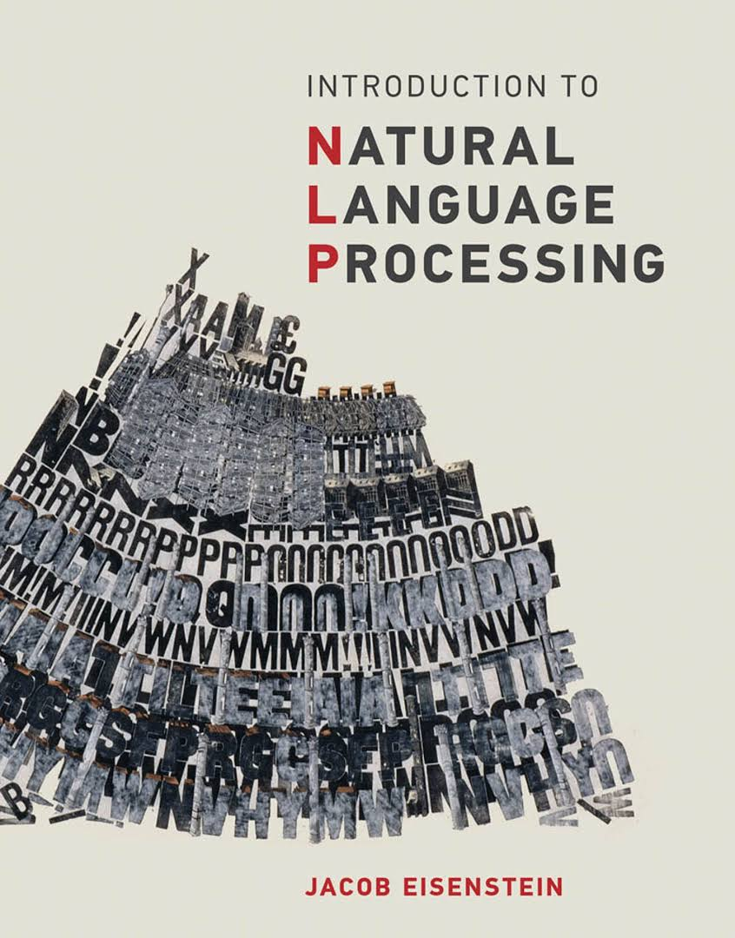
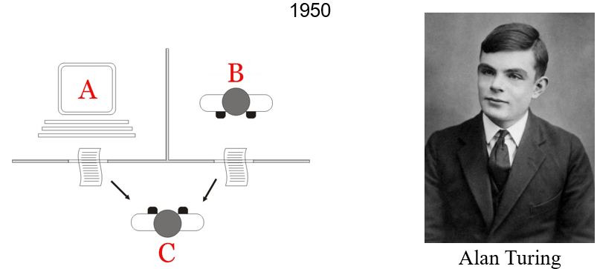

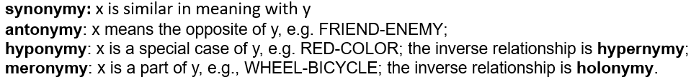
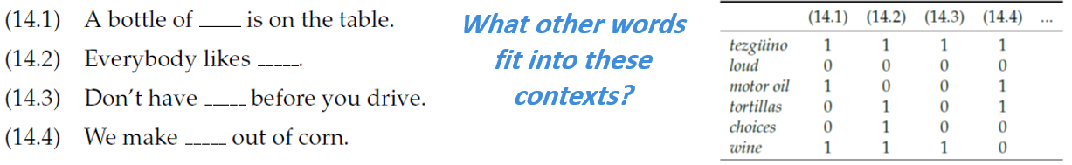
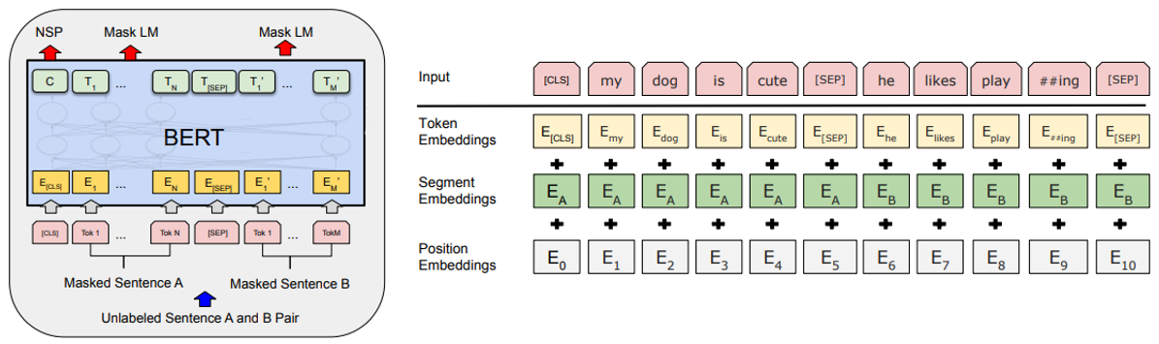
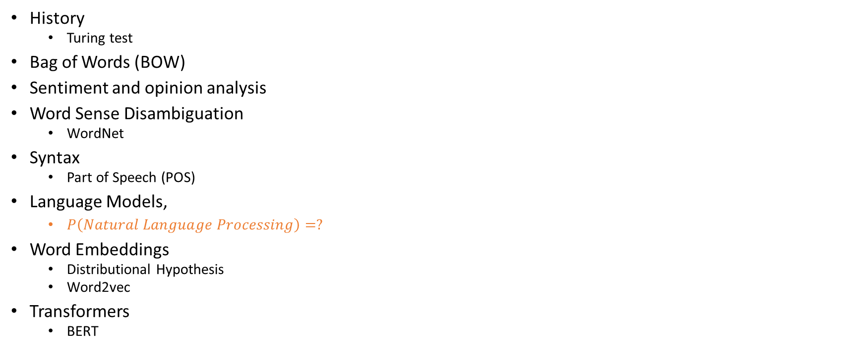
Natural Language Processing (NLP)
Jacob Eisenstein
That’s a great movie to take a nap afternoon with it.
History
Turing test
Bag of Words (BOW)
Sentiment and opinion analysis
Word Sense Disambiguation
WordNet
Syntax
Part of Speech (POS)
Language Models,
$P\left(Natural Language Processing\right)=?$
Word Embeddings
Distributional Hypothesis
Word2vec
Transformers
BERT
negation

Slide 4
Definition
Hybrid Learning
Hybrid systems
Neuro-symbolic AI
Symbol-manipulation
Symbolic AI
Knowledge-driven, Reasoning-based, centered around cognitive models
Informed ML
Data-driven and knowledge driven learning
…

Slide 5

Trend No. 1: Operationalizing AI initiatives
Trend No. 2: Efficient use of data, models and compute
“Combining "connectionist" AI approaches like deep learning, with "symbolic" AI approaches like rule-based reasoning, graph analysis, agent-based modeling or optimization techniques. ”
Trend No. 3: Responsible AI
Trend No. 4: Data for AI

Slide 6
Hybrid system
Hybrid architecture
Hybrid Learning
Variable Grounding and Symbol Manipulation
Commonsense and Combinatorial Reasoning
End to end Learning
Logic Translator
Paradigm for Learning?
Network Architecture
Loss Function
Probabilistic graphical models
Neural Network
Neural-Symbolic
Cognitive Reasoning
Neural-Symbolic
Learning Systems
Encode
Term/Reg
LTN
SL

Slide 7
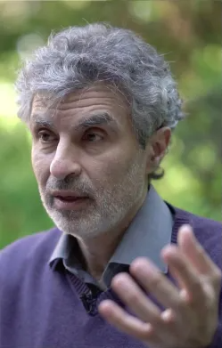
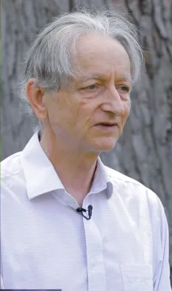
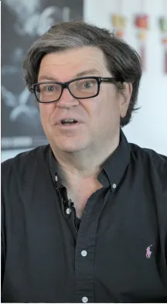
ML
Supervised Learning
requires a large amount of human-labeled data
Reinforcement Learning
requires a very large number of interactions
“The brittleness of deep learning systems is largely due to machine learning models being based on the independent and identically distributed (i.i.d.) assumption”
… Unfortunately, this is not a realistic assumption in the real world

Slide 8
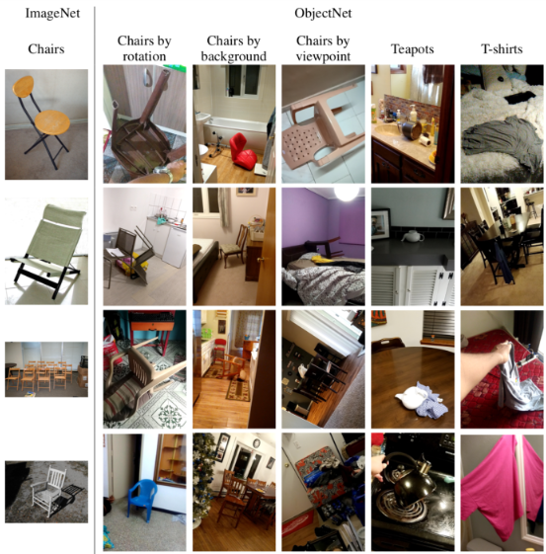
objects in the real world
Current status of AI
Human capabilities still lacking in AI
Adaptability
Generalizability
Robustness
Explainability
Abstraction
Common sense
Causal reasoning
Objects in training datasets

Slide 9
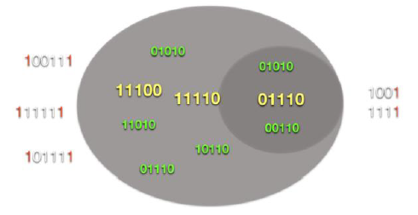
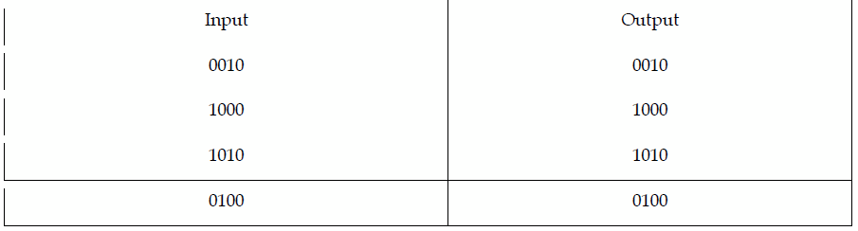
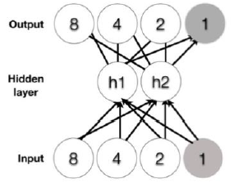
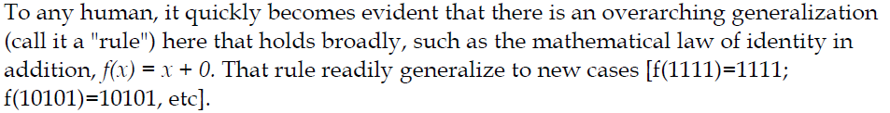
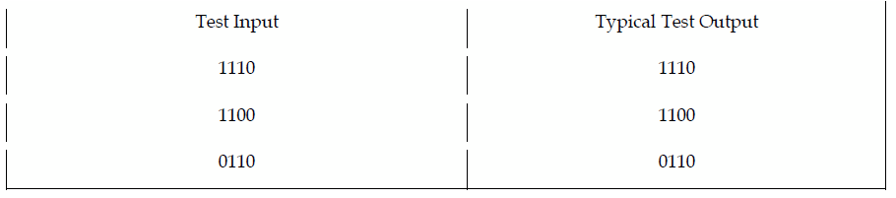
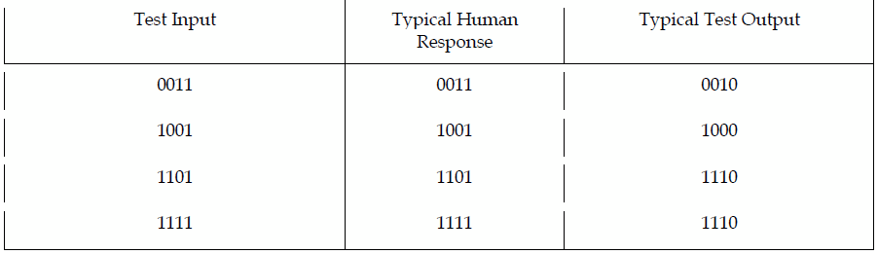
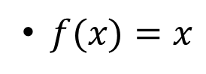
Identity function
$f(x)=x$
Multi layer perceptrons: good at generalizing within the space of training examples poor at generalizing the identity function outside the space of training examples. Even by adding more layers not working
Inside the training distribution
A multilayer perceptron trained by backpropagation responds to something different; the rightmost node has always been a zero, and so the network continues to predict that the rightmost node will always be a zero, regardless of the nature of the input, yielding, for example, f(1111)=1110.
outside the training distribution

Slide 10

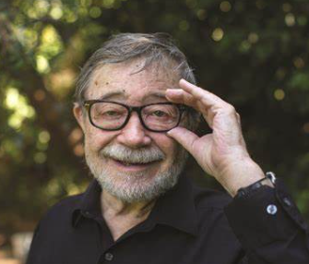
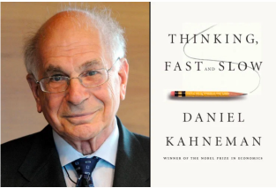
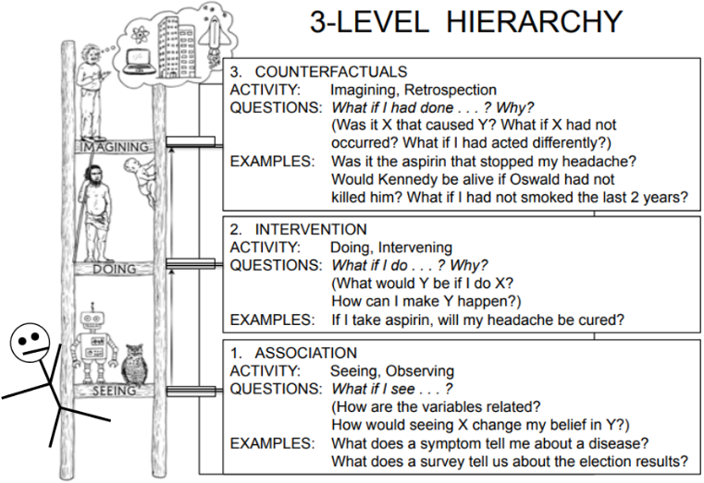
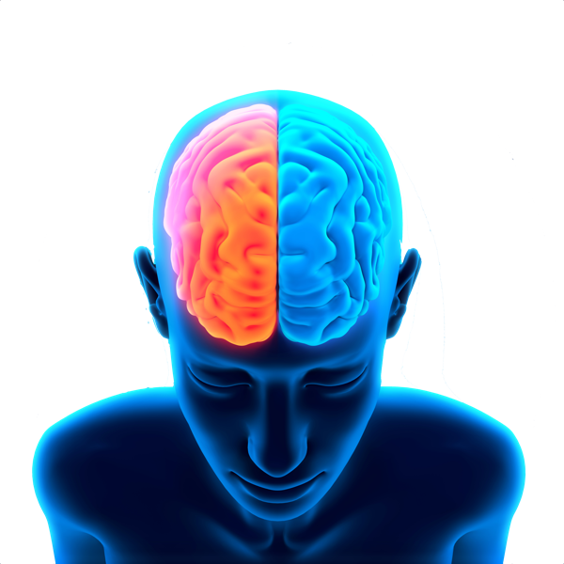
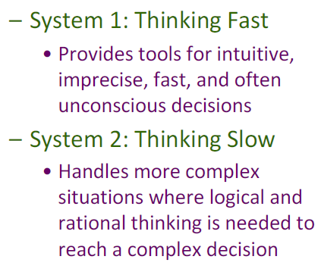
Curve fitting
Trying to induce how the world works through approximating the curves of the statistics of how words are used, rather than inducing a more abstract, causal understanding of the world.
A good way to light a fire is to use a dry cotton ball to cover the fuse
A good way to light a fire is to use a pint-sized furnace.
If our systems rely on curve-fitting and statistical approximation alone, their inferences will necessarily be shallow
“...so far as I’m concerned, System 1 certainly knows language... System 2... does involve certain manipulation of symbols.”
GPT-2

Slide 11

“The performance of today’s best AI systems tends to take a hit when they go from the lab to the field”
What to do?
Train on more data.!?

Slide 12

MEENA Google
Trained on a massive 341 GB corpus, almost ten times the size of what GPT-2 was trained on , and the equivalent of roughly 341,000 books, far more than most people read in a lifetime.
Like GPT2, Meena produces prose that is both remarkably fluent and also remarkably on topic.
Its best dialogs are stunning, and the paper reports that it sets a new state of the art in new measure of "Sensibleness and Specificity".
But the same core foundation—an internal cognitive model of the world—is still missing.
Each answer is coherent, but there is no coherence from one answer to the next.
Meena captures the fact that certain phrases like band names are often correlated with phrases like "favorite band";
But there is no enduring record of Meena’s preferences, even for the length of a short conversation
Conversation 61
Human: What's your favorite band?
Meena: Avenged sevenfold.
Human: Ooh, that's a good answer! What's your least favorite band?
Meena: Avenged sevenfold.
Human: Oh, i thought you liked Avenged sevenfold?
Meena: Yeah. That's my favorite band.
https://github.com/google-research/google-research/blob/master/meena/meena.txt

Slide 13
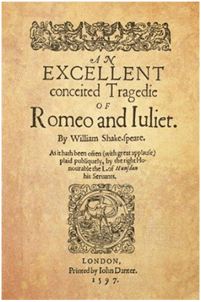

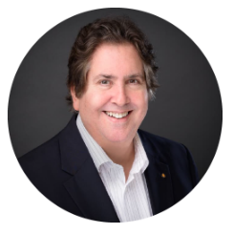
In the history of AI, the single largest effort to create commonsense knowledge in a machine--interpretable form, launched in 1984 by Doug Lenat, is the system known as CYC.
A symbolic machine, A combination of sophisticated reasoner and large-scale knowledge base.
It has required thousands of person--years, an almost Herculean effort, to capture facts about psychology, politics, economics, biology, and many other domains, all in a precise logical form.
“An example of rich cognitive model”
It is an internal distillation of a complex scenario
It filled with subtle information about what particular protagonists do and know and intend and expect at particular timepoints.
“Garcia is finishing a marathon run,”
It is a failure regarding of spending a lot of efforts, some magical results from transformers and GPT-2 even without explicit knowledge engineering.
“Garcia is wet”

Slide 14

symbol-manipulation
Symbol-manipulation, particularly the machinery of operations over variables, offers a natural though incomplete solution to the challenge of extrapolating beyond a training regime.
variables, bindings, instances, And operations over variables
It also provides a clear basis for representing structured representations(such as the tree structures that are taken as bedrock in generative linguistics) and records of individuals and their properties.
What it lacks is a satisfactory framework for learning.
Hybrids could be a way of combining the best of both worlds.
the capacity to learn from large scale data sets,
the capacity to represent abstract representations.
Gary Marcus: “I conjecture that they are a prerequisite for safely arriving at robust intelligence”

Slide 15



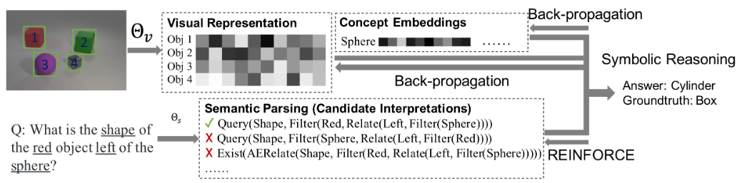
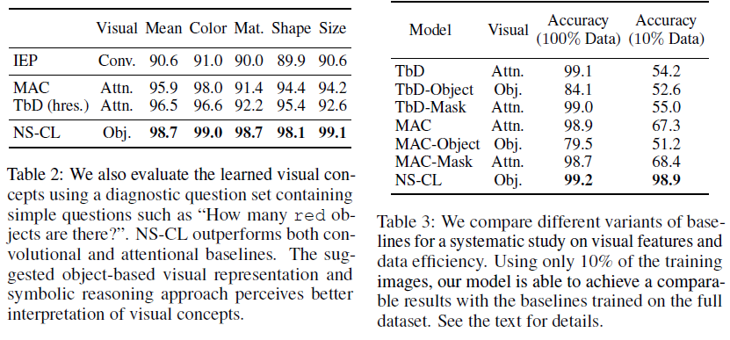
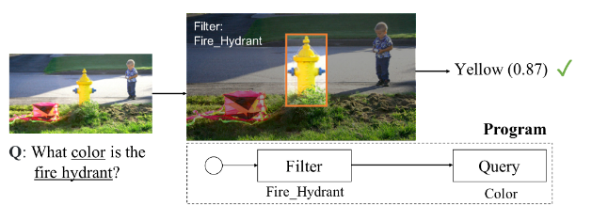
Neuro-Symbolic Concept Learner (NS-CL)
The model builds an object-based scene representation and translates sentences into executable, symbolic programs.
It uses a neuro-symbolic reasoning module that executes these programs on the latent scene representation.

Slide 16



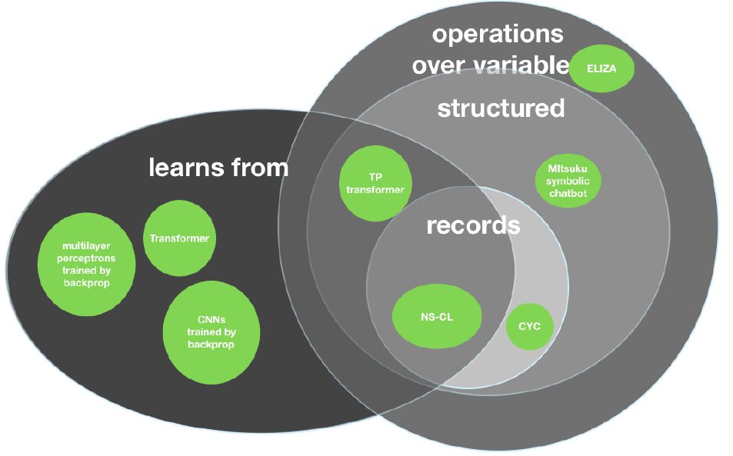
Others are also using it…
Google:
Deep Learning (e.g., BERT, RankBrain)
Google Knowledge Graph
AlphaGo:
DL
Monte Carlo Tree Search
OpenAI's Rubik's solver
DL
Asymbolic algorithm for solving the cognitive aspects of a Rubik'scube,
Robust AI resides in the intersection of Learning and Symbol Manipulation

Slide 17

What we want?
What we lack?
What we did?
What to do?
General intelligence humans have
Reasoning
Cognitive models
Dealing with Adversarials
Dealing with Counterfactuals
Trust
Generalization and extrapolating
Explainability
Robust system
Symbolic AI (1st wave)
CYC
Neural network and Deep learning (2nd wave)
GPT-2
MEENA
Bring the best of both together (3rd wave)
NS-CL
?

Slide 18
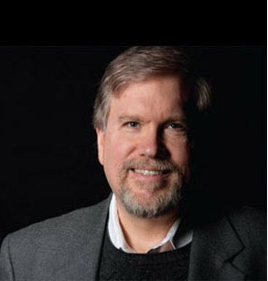
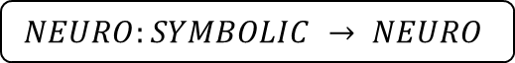
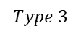
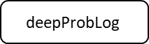


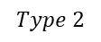
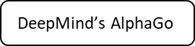
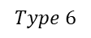

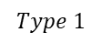

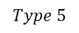
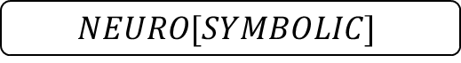

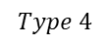
A taxonomy for neurosymbolic AI
Henry Kautz
standard deep learning, input and output of a neural network can be made of symbols
$$Type 1$$
$$SYMBOLIC NEURO SYMBOLIC$$
GNN/GCN
core neural network is loosely-coupled with a symbolic problem solver (Monte Carlo tree search)
$$Type 2$$
$$SYMBOLIC[NEURO]$$
$$\text{DeepMind}\text{’}\text{s} \text{AlphaGo}$$
a neural network focusing on one task interacts via input/output with a symbolic system specializing in a complementary task
$$Type 3$$
$$NEURO;SYMBOLIC$$
$$\text{deepProbLog}$$
$$NSC$$
$$Type 4$$
symbolic knowledge is compiled into the training set of a neural network, symbolic knowledge translated into the initial architecture of neural network
DEEP LEARNING FOR SYMBOLIC MATHEMATICS
$$NEURO:SYMBOLIC → NEURO$$
$$Type 5$$
tightly-coupled neural-symbolic systems where a symbolic logic rule is mapped onto a distributed representation (an embedding) and acts as a soft-constraint (a regularizer) on the network’s loss function.
$${NEURO}_{SYMBOLIC}$$
LTN
$$Type 6$$
Capable of true symbolic reasoning inside a neural engine. It is what one could refer to as a fully-integrated system
$$NEURO[SYMBOLIC]$$
Neural-Symbolic Cognitive Reasoning

Slide 19
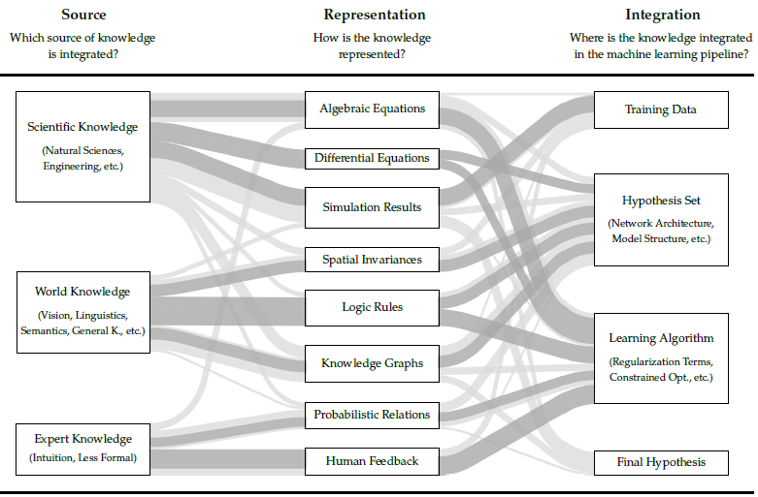
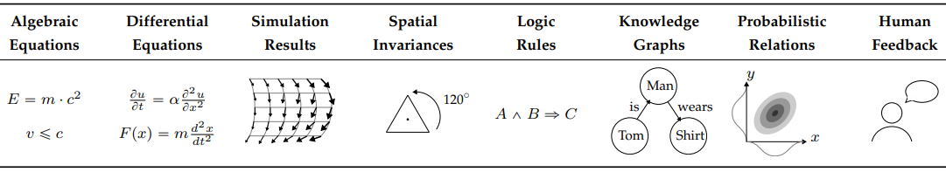
Feature Engineering
A second dataset
mapping of knowledge elements, such as symbols of a logic rule, to particular neurons
Informed Machine Learning
Modifying loss function according to additional knowledge
Discard predictions that do not agree with known constraints

Slide 20
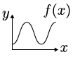
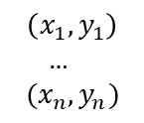
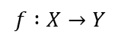
Pipeline
Problem:
Data:
Solution:
$$\left(x_{1},y_{1}\right)$$
…
$$(x_{n},y_{n})$$
ML Pipeline
$$f :X→Y$$
Training Data
Hypothesis Set
Learning Algorithm
Final Hypothesis

Slide 21
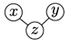
Pipeline
Problem:
Data:
Solution:
$$\left(x_{1},y_{1}\right)$$
…
$$(x_{n},y_{n})$$
ML Pipeline
$$f :X→Y$$
Training Data
Hypothesis Set
Prior Knowledge
Learning Algorithm
Final Hypothesis

Slide 22
Pipeline
Problem:
Data:
Solution:
$$\left(x_{1},y_{1}\right)$$
…
$$(x_{n},y_{n})$$
ML Pipeline
$$f :X→Y$$
Where?
Training Data
Hypothesis Set
How?
Prior Knowledge
What?
Learning Algorithm
Final Hypothesis
How?

Slide 23
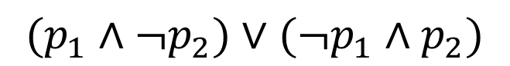
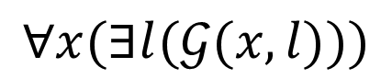
Logic
Propositional logic (PL)
First order logic (FOL)
One of the current limits of neural networks
Higher order logic
Additional quantifiers
Stronger semantics
$$(p_{1}∧{¬p}_{2})∨({¬p}_{1}∧p_{2})$$
$$∀x(∃l(𝒢(x,l)))$$

Slide 24
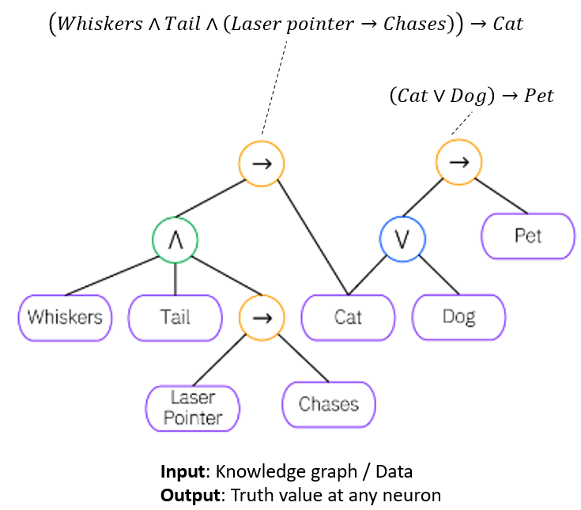
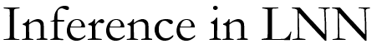






Logical Neural Networks (LNN)
Every neuron has a meaning as a component of a formula in a weighted real-valued logic.
The central idea is to create a 1-to-1 correspondence between neurons and the elements of logical formulae, using the observation that the weights of neurons can be constrained to act as, e.g. AND or OR gates.

Slide 25



Logic Tensor Networks (LTN)
Logic Rules:
$$∀ x (Smoke\left(x\right)→Cancer(x))$$
Generate Axioms:
Using LTN language all the rules as the axioms of a knowledge-base are generated
LTN Language:
LTN has its own language that allows to ground the predicates and symbolic Connectives;
$Smoke$ and $Cancer$ will be grounded as a simple $MLP$, and $→$ will be grounded as a $LTN wrapper$ that can be applied on $fuzzy$ operands
LTN Training:
A satisfiability aggregator is used to calculate many-valued fuzzy logic interpretation of the generated axioms, final loss function would be:
$$Loss=1 −SAT(Axioms)$$

Slide 26

Grounding using Data

Slide 27

The t-conorms of interest
AND
OR

Slide 28




Common Aggregation and Implications Operators
$$a→c$$
$$¬a∨c$$

Slide 29



Implementing Real Logic in Tensor Networks
For the Functions:
For the Predicates:
generalization of the neural tensor network from
“In particular, the parameters of predicates, functions, and constants will have been learned by using both data (to ground the formulas) and logical reasoning (at the loss function).”

Slide 30






Loss function in LTN
Define using pMeanError aggregator
we want to learn the parameters $θ$ (embeddings + MLPs of predicates) in such a way the axioms in the knowledge base are maximally satisfied

Slide 31



Experience (LTN)
Data: Stanford Sentiment Treebank
Model | Accuracy (%)
Baseline | 0.865
-Rule-p -Rule-q | 0.888 0.893
LTN | 0.933
Logic Rule: FOL

Slide 32





Prior Knowledge
“person wearing glasses”
$$(p⇒q)∧m∧n$$
$$p≡wear(person,glasses)$$
$$q≡in(glasses,person)$$
$$m≡exist(person)$$
$$n≡exist(glasses)$$

Slide 33





Embedding Symbolic Knowledge into Deep Networks
For example, cross-entropy for classification
the embedding distance between the formula related to the input $x$ and the predictive distribution $h(x)$
$$q( )$$

Slide 34


Interpretable Multimodal Retrieval for Fashion Products
After the end-to-end training, we leverage the learned EI
tree weights to localize fashion concepts
EI tree guides the learning procedure and obtain meaningful representations where each dimension corresponds to a concrete fashion concept.
Offline
ResNet-50
Search for similar items
Online
User
feedback
Similar items
Are retrieved
Text description
Image
query
Vector representation

Slide 35









Representation Learning
Semantical path from $c_{0}$ to $c_{n}$
Exclusive steps
Independent steps
Example:
EI Tree loss function:
Softmax
Sigmoid
Offline loss function:
among the up_cloth and bottom_cloth category, forcing the model to choose only one of them
after choosing the up_cloth category, the neckline and sleeve are decided independently

Slide 36











Interpretable Fashion Retrieval
Integration of User Feedback
Offline
1
$$v=[p,f]$$
2
Collection
3
4
5
$$v_{t+1}$$
give “yes”/“no” feedback on fashion concepts to state which concepts are in or not
$t$-th iteration
6

Slide 37

Judgment Prediction via Injecting Legal Knowledge into Neural Networks
The goal of Legal Judgment Prediction (LJP) is to predict a law case’s judgment based on a given text, which describes the finding facts of the law case.
Most of previous works treat LJP as a text classification task.
The advantages of representing legal knowledge as first-order logic rules have two folds.
It makes judgment prediction more interpretable, which is critical in the legal domain.
logic rules provide models with inductive bias, which reduces the dependency of neural networks on data

Slide 38













Which parts of the claims are significant for the prediction
Overall training workflow
Co-Attention Networks
Objective to maximize
Word Embedding Layer
Contextual Representation Layer
Implicit reasoning
Knowledge Injection
Attention Layer
$$Γ\left(X_{i}\right)=x_{i}$$
Legal Knowledge:
if the current claim is for interest
Heuristic Rules
Output Layer

Slide 39







Physics-informed neural network: Neural networks that are trained to solve supervised learning tasks while respecting any given laws of physics.

Slide 40









Our experiments in NLP group
Problem:
Data:
Solution:
$$\left(x_{1},y_{1}\right)$$
…
$$(x_{n},y_{n})$$
ML Pipeline
$$f :X→Y$$
Training Data
Prior Knowledge:
Hypothesis Set
Extract Knowledge
Represent Knowledge
Word knowledge
Manually
Logic Rules
Learning Algorithm
Expert knowledge
Semi-Auto
Knowledge Graphs
Final Hypothesis
$$A∧B⇒C$$
is
Man
wears
Tom
Shirt
Grounding Predicates
Sentential Decision Diagrams (SDD)
Rule Parsing
Factorization Encoder
Graph Convolutional Networks
LTN
SL
KENN
GP
GCN
Satisfiability
Weighted Model Counting (WMC)
Activation Function
Graph Laplacian
Graph Laplacian

Slide 41
Knowledge Compilation
Knowledge compilation is an area of research with a long tradition in artificial intelligence.
A key aspect of any compilation approach is the target language into which the propositional theory is compiled.
Sentential decision diagrams (SDDs) are restricted structured d-DNNFs which have turned out to be a promising representation language for propositional knowledge bases.

Slide 42









d-DNNF
Adnan Darwiche is a professor and former chairman of the computer science department at UCLA
A negation normal form (NNF) is a rooted Directed Acyclic Graph (GAG) in which each leaf node is labeled with a literal, $true$ or $false$, and each internal node is labeled with a conjunction $∧$ or disjunction $∨$.
For any node n in an NNF graph, $Vars(n)$ denotes all propositional variables that appear in the subgraph rooted at $n$, and $∆(n)$ denotes the formula represented by $n$ and its descendants.
Decomposability holds when $Vars(n_{i}) ∩ Vars(n_{j}) = ∅$for any two children $n_{i}$ and $n_{j}$ of an and-node $n$.
Determinism holds when $∆(n_{i}) ∧ ∆(n_{j} )$is logically inconsistent for any two children $n_{i}$ and $n_{j}$ of an or-node $n$.
or
and
and
$$∆\left(n_{i}\right)∧ ∆\left(n_{j} \right)=\left(¬A and B\right) ∧ \left(¬B and A\right)$$
$$¬A$$
$$B$$
$$¬B$$
$$A$$
$$Vars(n_{i}) ∩ Vars(n_{j}) = ∅$$

Slide 43








A Semantic Loss Function for Deep Learning with Symbolic Knowledge
enforced through a logical constraint α
At most one variable is true
At least one variable is true
$$¬X_{1}∨¬X_{2}$$
$$¬X_{1}∨¬X_{3}$$
$$¬X_{1}∨¬X_{4}$$
…
$$X_{1}∨…∨X_{n}$$
exactly-one or one-hot constraint capturing the encoding used in multi-class classification.
It states that for a set of indicators $X = \{X_{1}, . . . , X_{n}\}$, one and exactly one of those indicators must be true, with the rest being false.
SDD
WMC

Slide 44





SL
Logic Rules:
$$if S.Contains\left(w_{i}\right)→ \left(x_{1}∧{−x}_{2}\right) ∨({−x}_{1}∧x_{2})$$
Identify $if$ side:
For satisfying logic rule only for the instance under $if$ statemen, a new vector/column $v_{1}$ concatenated to the labels to be send to the training
$$Concat(\begin{matrix}0 & 0 & 1 \\ 1 & 0 & 0 \\ 0 & 1 & 0\end{matrix},\begin{matrix}0 \\ 1 \\ 1\end{matrix})$$
Graph Generation:
For each rule, unique $SDD$ and vtree graphs are generated to be used later for Weighted Model Counting ($WMC$) that put limitation on output distribution
In case of image
Processing we can use
A new predicate with
training data
SL Training:
During training the model, a new loss function created by adding an addition term:
$$Loss={CrossEntropy}_{Data}+λ× v_{1}×WMC$$
In case of using a new predicate
for Contains rule, we shouldn’t
multiply its output, instead the
constraint will be added to the
SDD as :
$$A⇒B to −A∨B$$

Slide 45











Incorporating Taxonomy Tree
A logic rule for second branch of the first level $a_{2}$ would be:
$$\left.l_{2}={\left(¬x\right.}_{1}∧¬x_{2}∧{¬x}_{3}∧ x_{4}∧ {¬x}_{5 }∧ {¬x}_{6}\right)∨$$
$$\left.{\left(¬x\right.}_{1}∧¬x_{2}∧{¬x}_{3}∧ ¬x_{4}∧ x_{5 }∧ {¬x}_{6}\right)$$
from taxonomy tree if $a_{2}=1$ then $l_{2}$ should be satisfied, which means one of the $x_{4}$ or $x_{5}$ should be one and the rest zero
SDD for logic $l_{2}$, $A,B,C,D,E,F$ correspond to $x_{1},x_{2},x_{3},x_{4},x_{5},x_{6}$, respectively, Which is equal to logic represented in Conjunctive Normal Form (CNF) in $l_{2}$. But, it is tractable and differentiable and can be used in our final loss function.
For a taxonomy with $𝔸=\{A_{1},…,A_{m}\}$ levels, and each level with $A_{1}=\{a_{11},..,a_{1b}\}$ branches, then, for a branch we have:
$$A∈ℕ^{N×b}, ℕ∈\left\{0,1\right\}$$
$$S∈ℝ^{b×1}$$
where $S$ is SDDs for level $m$. The final loss function to train would be:
$$Loss=CrossEntropy\left(p,t\right)−\sum_{i=1}^{N}{\bigwedge_{j=1}^{m}{λ×log\left({WMC(A}_{j}.S_{j})\right)}}$$

Slide 46






WMC

Slide 47


















Incorporating Taxonomy Tree
Supervised classification by integrating taxonomy tree as the prior knowledge used in labeling.
labels
$$a_{2}$$
$$a_{1}$$
.
.
batch
$$l_{3}$$
targets
$$t$$
$$−$$
$$l_{2}$$
$$s_{2}$$
$$a_{2}$$
$$l_{1}$$
$$s_{1}$$
$$a_{1}$$
$$∧$$
$$l_{1}$$
$$l_{2}$$
$$l_{3}$$
$$CrossEntropy(l_{3},t)$$
$$−$$
$$λ×log( wmc )$$

Slide 48







Incorporating Taxonomy Tree
Semi-supervised classification by integrating taxonomy tree as the prior knowledge used in labeling.
labels
$$a_{2}$$
$$a_{1}$$
$$l_{3}$$
.
.
batch
targets
$$t$$
$$−$$
$$l_{2}$$
$$s_{2}$$
$$a_{2}$$
$$−$$
$$l_{1}$$
$$s_{1}$$
$$a_{1}$$
$$CrossEntropy(l_{3},t)$$
$$−$$
$$λ_{2}×log(({wmcl}_{2}.s_{2}))$$
$$−$$
$$λ_{1}×log(wmc(l_{1}.s_{1}))$$
$$Loss=\frac{1}{N}\left(\sum_{labeled}{CrossEntropy\left(p,t\right)}−\sum_{unlabeled}{\sum_{i=1}^{u}{\sum_{j=1}^{m}{λ_{j}×\log\left(wmc(A_{j}.S_{j})\right)}}}\right)$$
$$l_{1}$$
$$l_{2}$$
$$l_{3}$$

Slide 49
Lenovo Mall Data
Data Introduction
user queries came from Lenovo Mall
each sentence label is one of 84 classes
Taxonomy
Level 1, including 18 domains
电脑、电脑配套设备、服务、综合办公用品、配件、电子产品、家居用品、软件、……
Level 2, including 45 intents
笔记本、台式机、电脑服务、电脑外设、系统软件、游戏设备、应用软件、车用电器、……
Level 3, including 84 sub-intents
硬件升级、打印机、CPU、鼠标、显示器、维修检测、键盘、内存、操作系统、个人云、碎屏处理、……
Train Data: 13962
Test Data: 1530

Slide 50
Experiments (fully-supervised)
Data
Lenovo-mall data
Settings
baseline, BERT base model fine-tune for text classification
+taxonomy, add semantic loss during training part by SDDs
Conclusion
Macro avg F1 increase means that a better performance in the smaller classes
exp | accuracy | macro avg F1 | weighted avg F1
tf-base | 0.9418 | 0.8212 | 0.9391
+taxonomy | 0.9425 | 0.8373 | 0.9402

Slide 51
China GEO Data
Data Introduction
user queries came from call center service in China GEO project
each sentence label is one of 134 classes
Taxonomy
Level 1, including 5 domains
故障类、查询类、设置类、维修类、销售类
Level 2, including 24 intents
系统故障、网络故障、bios故障、……
Level 3, including 134 sub-intents
蓝屏、不能上网、bios升级问题
Train Data: 19214
Test Data: 1619

Slide 52
Experiments (China Geo)
Settings
baseline, BERT base model fine-tune for text classification
+taxonomy, add semantic loss during training part by SDDs
Conclusion
with taxonomy, accuracy、weighted avg F1 increase means a better overall performance
besides, macro avg F1 increase means that a better performance in the smaller classes
exp | accuracy | macro avg F1 | weighted avg F1
SOTA | 0.75 | 0.57 | 0.76
tf-base | 0.74 | 0.59 | 0.75
+taxonomy | 0.76 | 0.61 | 0.77

Slide 53
Experiments (semi-supervised with using 20% labeled data)
Data
Lenovo-mall data
Settings
baseline, BERT base model fine-tune for text classification
+taxonomy, add semantic loss during training part by SDDs
Conclusion
with taxonomy, accuracy、weighted avg F1 increase means a better overall performance
besides, macro avg F1 increase means that a better performance in the smaller classes
exp | accuracy | macro avg F1 | weighted avg F1
tf-base | 0.8542 | 0.4478 | 0.8466
+taxonomy | 0.9111 | 0.6043 | 0.9007

Slide 54


Incorporating Knowledge Graph into Loss Function
Matrix Factorization AutoEncoder is commonly used for dimensional reduction and clustering. A low-rank matrix factorization can be applied to a matrix $M$:
$$M≈XY, where X∈ ℝ^{N×k} , Y∈ ℝ^{k×p} , k<p$$
In order to find a good solution an objective function can be:
$$arg\min_{X,Y}{{\left\|M−XY\right\|}_{F}^{2}+λR(X,Y)}$$
where $R(X,Y)$ is a regularizer for $X$, $Y$

Slide 55


Incorporating Knowledge Graph into Loss Function
Using graph Laplacian regularizer to punish the inconsistency between the learned $X$ ($Y$) and a network $G∈ ℝ^{N×N}$ ($G∈ ℝ^{p×p}$). $G$ can be obtained from a knowledge base or constructed using rules. By adding target labels we will have a supervised learning objective.
Cross Entropy
Reconstruction
Punishing Decoder
Punishing Encoder

Slide 56










Incorporating Knowledge Graph (20Newsgroups Dataset)
Obtain $G$ from pre-defined rules:
Documents including specific keywords are related.
Classes
Keywords
Relation
Graph
$$d_{1}$$
$$d_{5}$$
$$∀s (Containes\left(s, w_{i}\right)⇒ P_{i}\left(S\right))$$
$$iε\{1,2,..,20\}$$
$$d_{3}$$
$$d_{2}$$
$$d_{6}$$
$$d_{4}$$

Slide 57









Incorporating Knowledge Graph (20Newsgroups Dataset)
Obtain $G$ from external knowledge base WordNet:
Documents with the words/synsets which are related in WordNet ontology are related.
WordNet
Graph
$$d_{1}$$
$$d_{5}$$
Wu-Palmer similarity Matrix between Synsets
$$d_{3}$$
$$d_{2}$$
$$d_{6}$$
$$WuPalmer=2×\frac{depth\left(LCS\left(s_{i} , s_{j}\right)\right)}{\left(depth\left(s_{i}\right)+depth\left(s_{j}\right)\right)}$$
$$d_{4}$$

Slide 58










Incorporating Knowledge Graph
WordNet
Graph
Wu-Palmer similarity Matrix between Synsets
$$d_{1}$$
Obtain $G$ from external knowledge base WordNet:
Documents with the words/synsets which are related in WordNet ontology are related.
$$d_{5}$$
$$d_{3}$$
$$d_{2}$$
Graph Laplacian
$$d_{6}$$
$$d_{4}$$
.
To punish inconsistency between
Learned representation and
interaction graph G
M
Encoder
Decoder
Linear
Softmax

Slide 59
Incorporating Knowledge Graph (results)
exp | accuracy | macro avg F1 | weighted avg F1
tf-base | 0.72 | 0.69 | 0.72
+WordNet | 0.73 | 0.71 | 0.74
sample 2000 instances
All the instances
Data
20Newsgroups
WordNet results
Pre-defined rule results

Slide 60


Graph Convolutional Networks (GCN)
4
1
5
6
0
2
7
8
3
9

Slide 61
















Convert Tax. to Doc. Graph
$$d_{1}$$
$$d_{2}$$
$$d_{3}$$
$$d_{6}$$
$$d_{4}$$
6
$$d_{5}$$
$$d_{9}$$
2
7
$$d_{2}$$
$$d_{7}$$
$$d_{10}$$
8
$$d_{11}$$
$$d_{8}$$
$$d_{12}$$
$$d_{13}$$
$$d_{15}$$
$$d_{14}$$

Slide 62












GCN
$$d_{4}$$
$$d_{1}$$
$$d_{3}$$
$$d_{6}$$
Documents
Batch
$$d_{2}$$
$$d_{5}$$
$$d_{7}$$
Taxonomy
Backbone
Input layer
output layer
$$ℒ=ℒ_{0}+λℒ_{reg}$$
$$A$$
$$ℒ_{reg}={\left\|P−H\right\|}_{2}^{2}$$

Slide 63

Experiment (fully & semi-supervised)
Data
Geo
Setting
$Batch−size =32$, $λ=0.05$
exp | accuracy | macro avg F1 | weighted avg F1
tf-base | 74.98 | 58.49 | 75.18
+taxonomy | 75.90 | 59.12 | 76.57
Supervised
exp | accuracy | macro avg F1 | weighted avg F1
tf-base | 68.99 | 46.56 | 69.05
+taxonomy | 70.47 | 47.34 | 70.61
Semi-supervised
20% labeled

Slide 64
Challenges & discussion from my point of view
Understanding Data
Knowledge/logic statement, in a way that suit your data
Expressing/representing knowledge in a suitable language
PL
FOL
Model(s) building
Network
Activation function
Loss function
Validation
E.g., loss function validation (Differentiability, Monotonicity, Semantic equivalence, Identity, Label-literal correspondence)
Computation structure
Tensor network
Issue of stacking computation on GPU device
Batch computation
Graph
Variables (e.g., variables for imbalance data in LTN)
Available & correct
Knowledge Extraction
Need to be extract & validate
validation
Knowledge Representation?
Loss validation
NN validation
Rep validation
Knowledge validation
Rules
Graph
Model block?
NN
Loss function

Slide 65
Thank you!

